Slide 1



ESG Product Deck
Founded, Innovated and Built by Singaporeans
v0.1 | 02/01/2022

Slide 2

Introduction on ESG Food Waste Solution
Why is ESG important
Why is critical to start now
How to start
ROI
Actionable steps
Why us?

Slide 3

Why is ESG Important
The Inevitable
Climate impact - The regulation body will tighten and enforce
The Money
Investing Strategies - look at companies that align behind ESG principles and their engagement, including Fund Managers
Early mover advantage for Green Financing
Estimated 1 Trillion to be invest into ESG companies by 2030
We have entered a NEW ERA
The Workforce
Employees Market - Attracting Talents & Talents retention for company growth, Millennials selects companies that aligns to their own ESG beliefs
3

Slide 4

Why is ESG Important
Because Singapore Cares!
Global waste problem: By 2050, estimated that annual global solid waste generation.
2.0 billion tonnes
3.4 billion tonnes
69%
How often you rush into something and still get the best?
Wasted (Food Product Lost or Wasted): $936 Billion Every Year.
That’s 1/3 of Total Global Food Production
4.4 Gigatons of CO2: The size of a hundred million African elephants
250km3 water footprint on the 1/3 wastes: 100,000,000 Olympic Size Swimming Pool
4

Slide 5
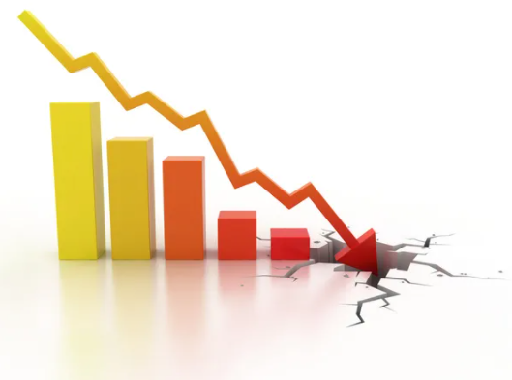
Why is ESG Important
What if Singapore supply gets disrupted?
Food Supply
90%
Amount that Singapore imports its food supply
The Reason why
Singapore would put emphasis
on Waste Management
Food Waste
11%
Of Food waste out of the total waste generated in Singapore.
Current amount of food waste
That is equivalent to 2 bowls of rice per person per day, or around 51,000 double decker buses.
Singapore has to start somewhere
5

Slide 6
Why is ESG Important for you
Comply to future regulation in time to come and when it matters
Exploring Green Financing and taking advantage now, for business expansion
Controlling what you can control! Cost Savings that benefits your business while in the midst of all these should be the goal.
How do you prepare ahead?
6

Slide 7

Why Critical to Start Now
Option 1
Start now, first mover advantage
Benefits:
Head start, start making returns from cost savings 2 years ahead
More money to focus on core business
Good advantage for Green Financing now
How often you rush into something and still get the best?
And you are ready for the compliance anytime.
Option 2
Wait first, start later.
Consequence:
You rush to get something done
You lost 2 years of cost savings doing the same thing eventually
Results not guaranteed when you rush
7

Slide 8
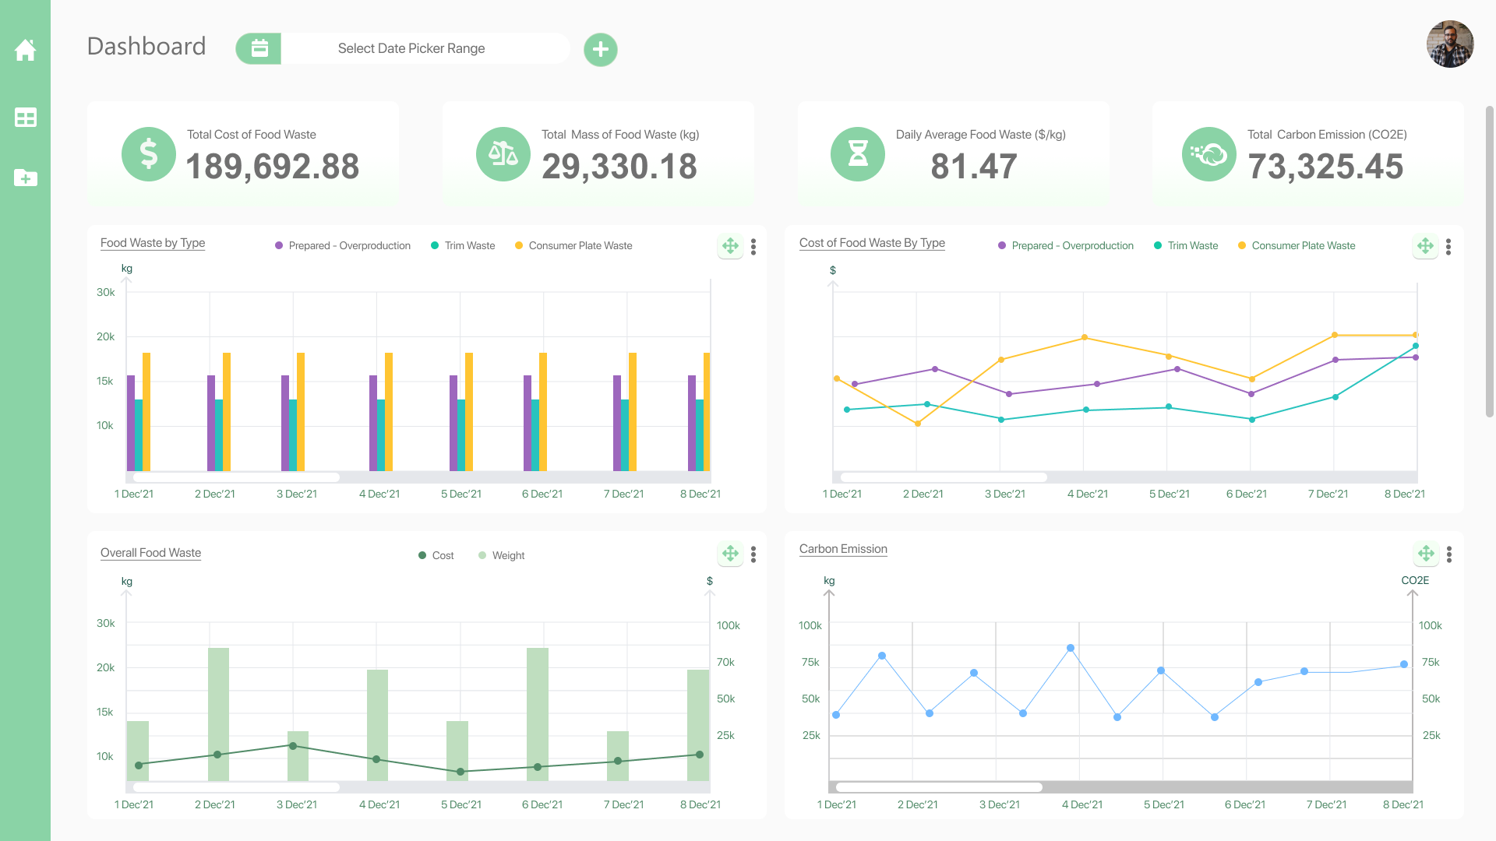
How to Start
Regulatory & Compliance (NEA)
To create a compliance report, you need data!
Real Solution MAP actionable steps for businesses
Measure the waste
Accurate assessment for target
Put plan into action
Simulator with formula to achieve significant savings.
MAP your actions
8

Slide 9
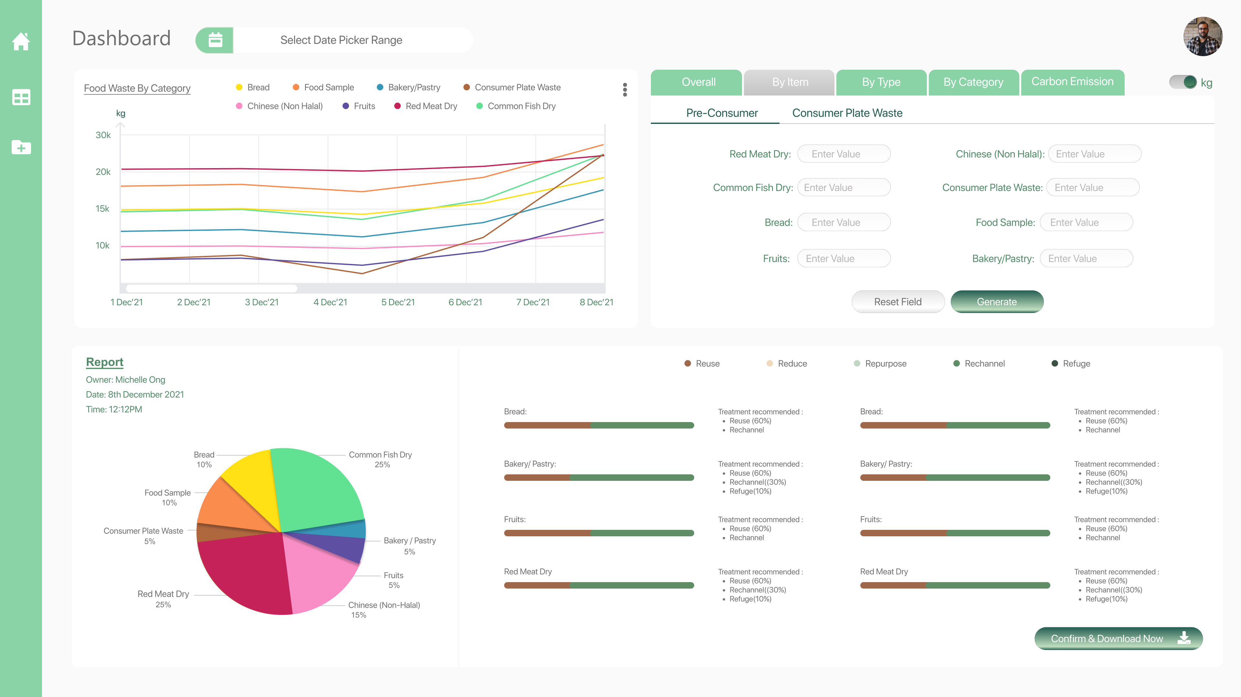
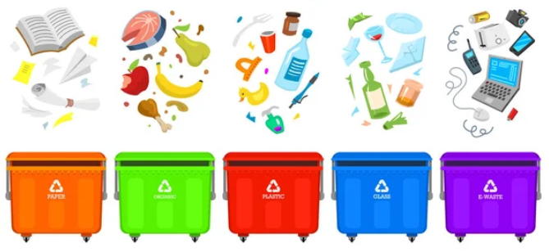
How to Start
Lack of Visibility
Get data analytics for insightful decisions to know where and how you can reduce and cut cost.
Actual report on how waste generated
Create plan and take actions with the knowledge
Treat waste with least cost by effective segregation
ACT and get results
9

Slide 10
How to Start
Fear of Spending
Creating ROI in less than 12 months
Perpetual savings thereafter and increased savings progressively if you manage it well
Get an opportunity to Green Financing to fuel your business growth
Long term sustainability is the key
Imagine yourself looking in hindsight, what would you want to be?
Glad I did it
I should have done it
10

Slide 11

Addressing the Problem
The struggles
Our Solution
Achieve compliance report to avoid fines & complications
Regulatory & Compliance
Lack of Visibility
Fear of Spending
Data analytics for insightful decisions for reducing cost
ROI > 12 months
Let us walk you through how it can be done
Notes:
https://cmas.org.sg/2017/10/16/the-unseen-scandal-of-hotel-food-waste/

Slide 12
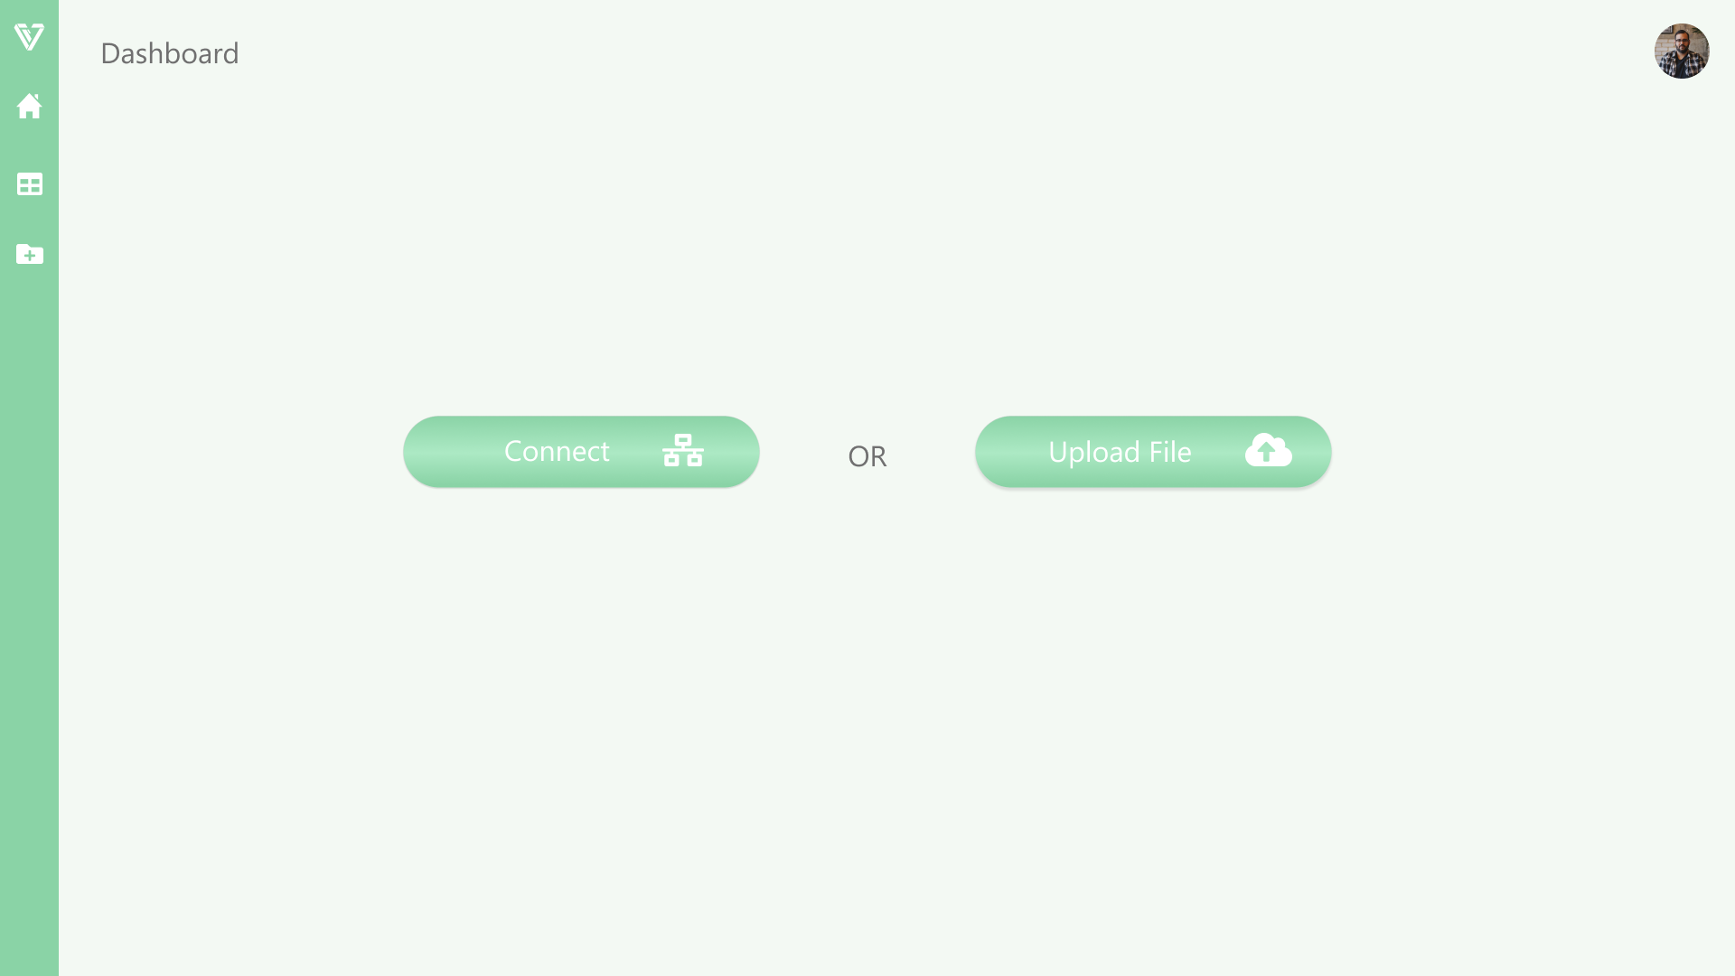
Input Data
1. Connect to system via API
2. Upload a file

Slide 13
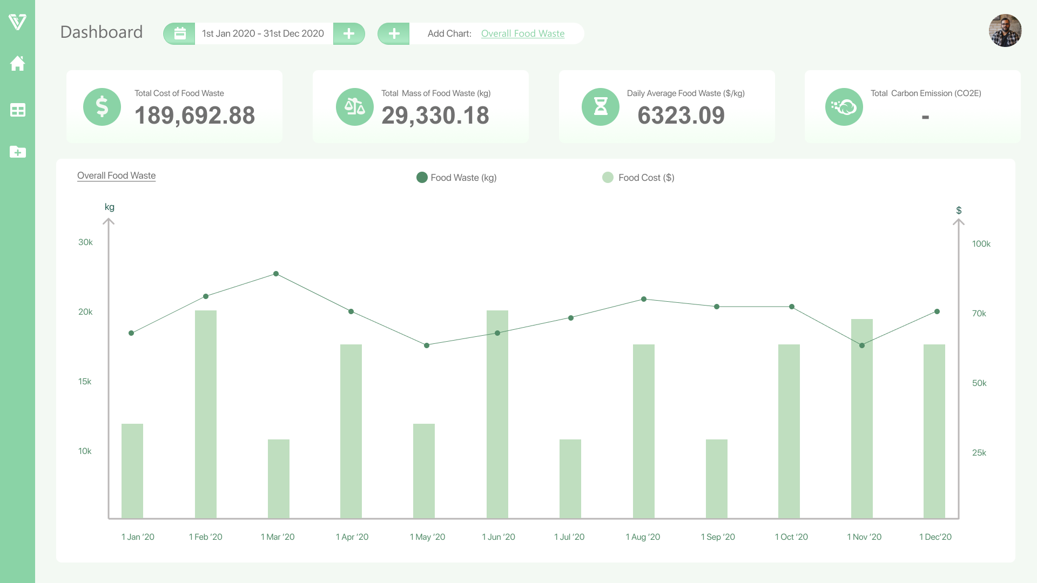
2. Select date range to display the period you want to see on the graph
Shows the data of the date range you have selected
4. Total cost of food waste
5. Total weight of food waste
6. Average cost of food waste
Visualisation of Data
1. Overall Graph that shows the dates selected by overall Food Waste Cost and Weight

Slide 14
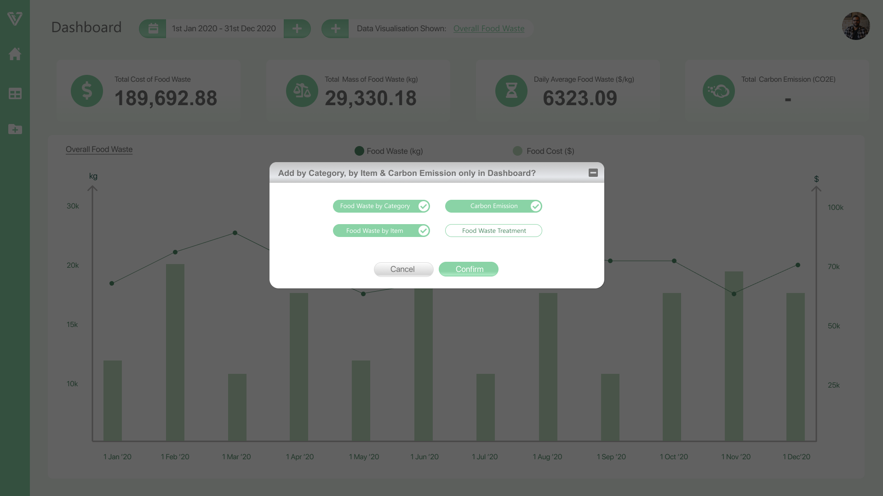

Add more visualisation for analysis
1. Select “Add Chart” to view charts from multiple categories
2. Select other categories you want to view

Slide 15
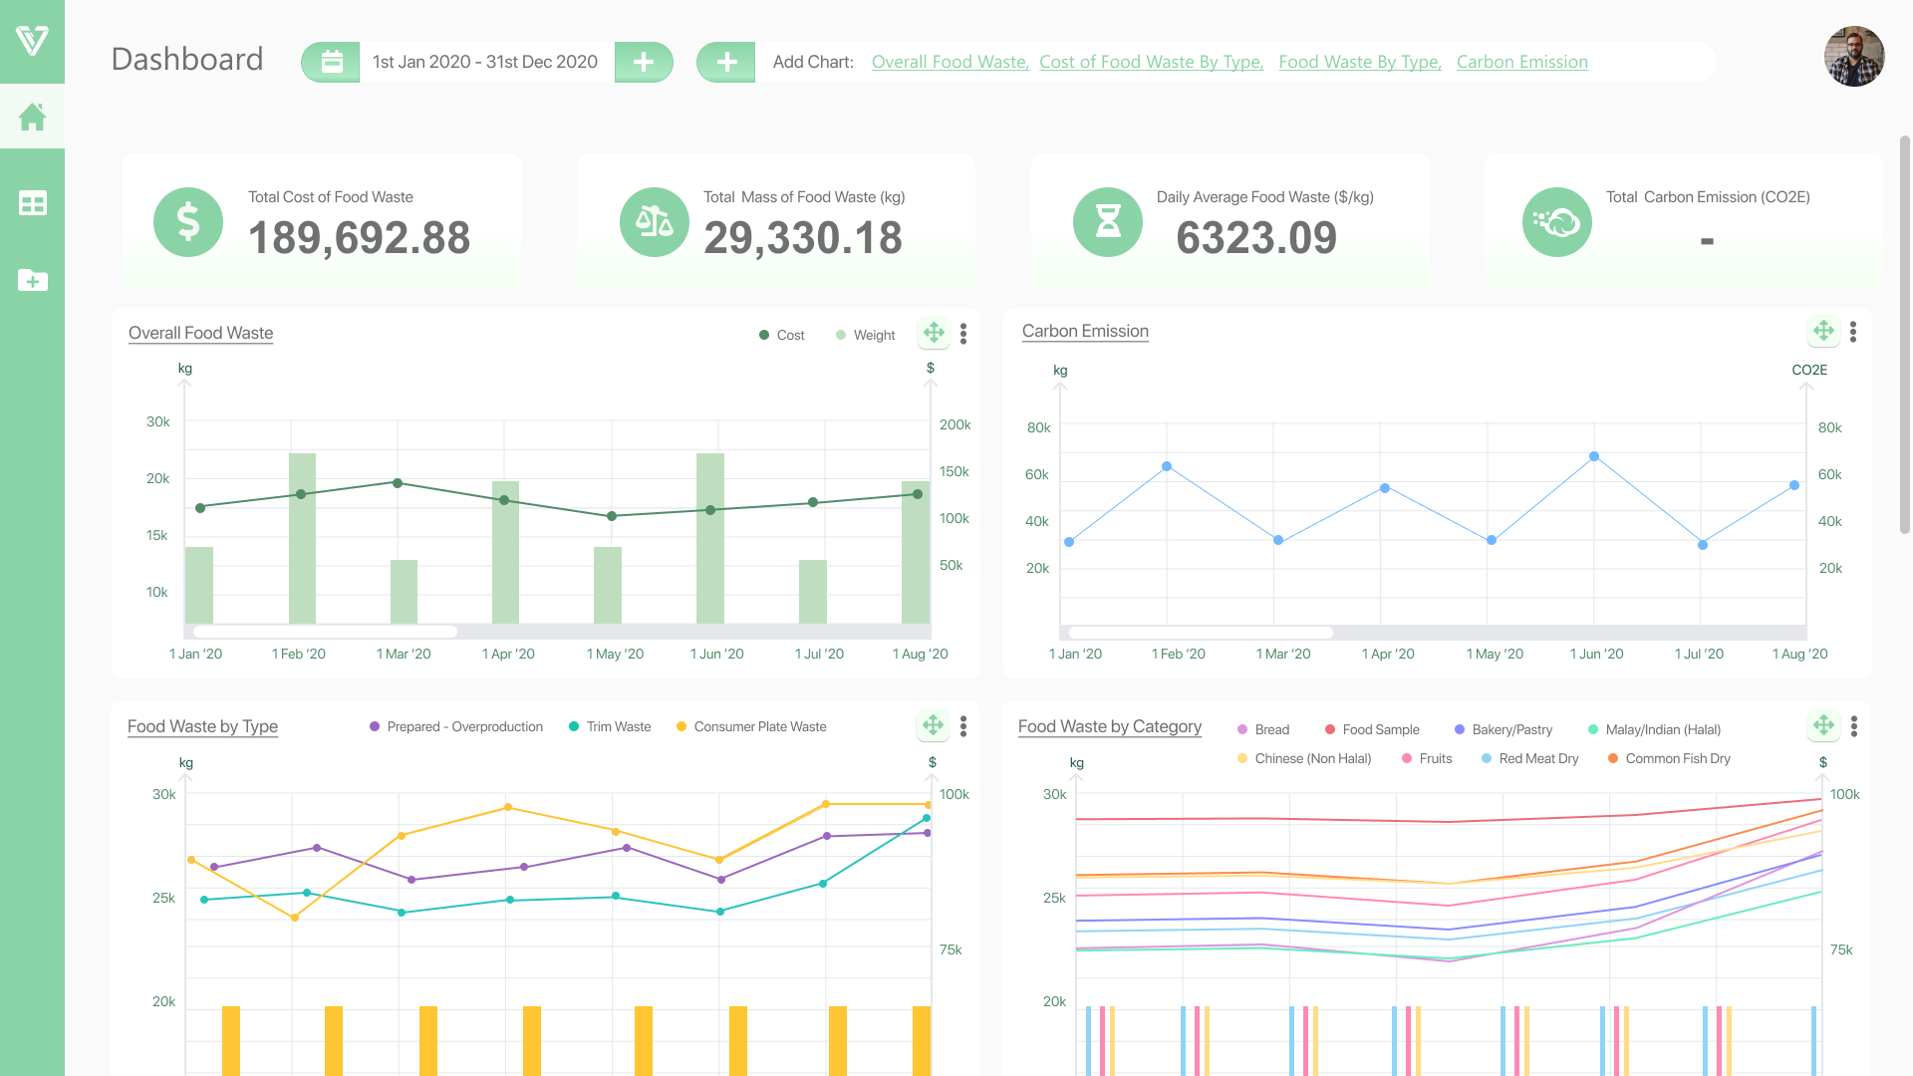
Measure Waste
1. You can now view multiple charts!
Carbon Emission
Food Waste by Type
And more!

Slide 16
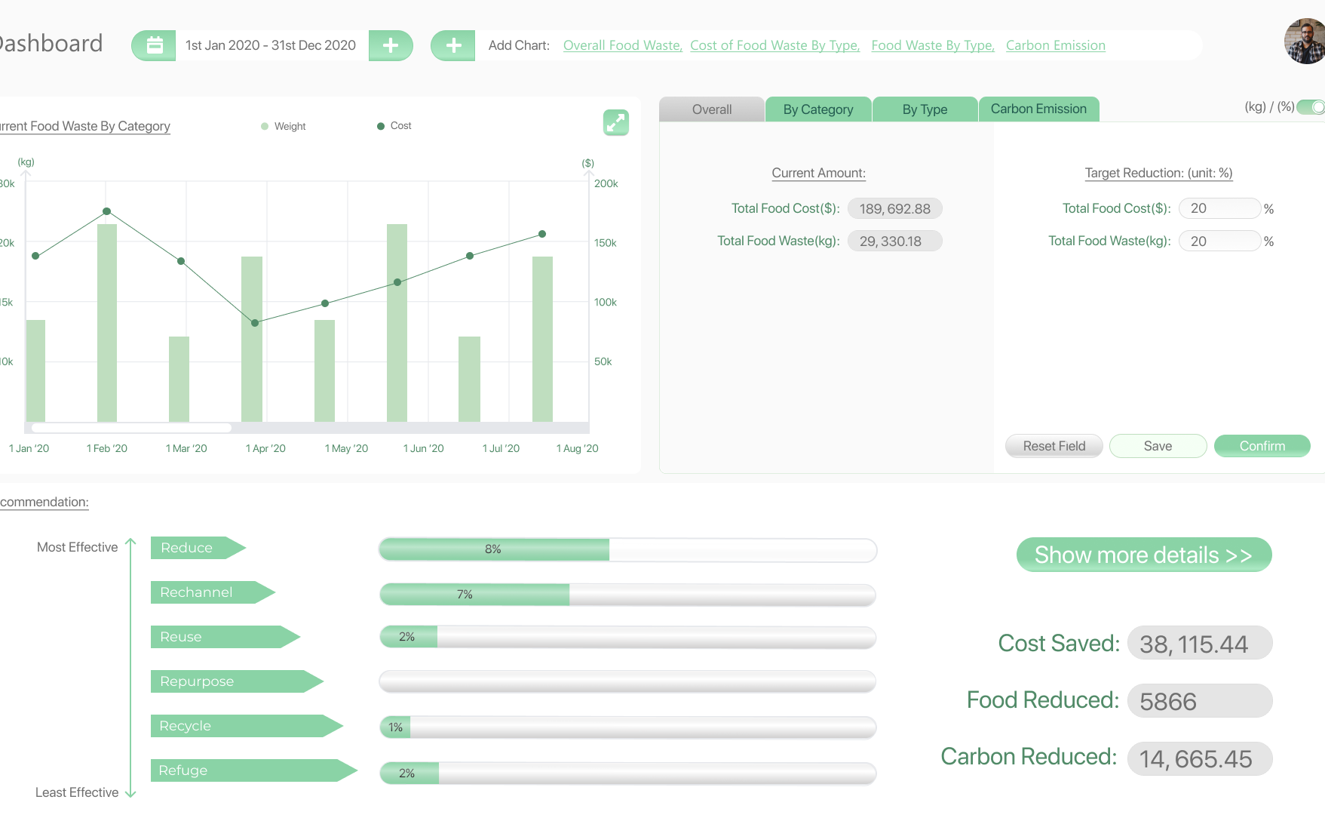
Simulator - ROI
1. Your current amount of Food Waste & Cost
2. Forecast your savings by entering the amount you want to reduce
3. Click on “confirm” and it will generate the results
3. Once you key in your value in step 2, you can visualise the results of your forecast for savings of 20%

Slide 17
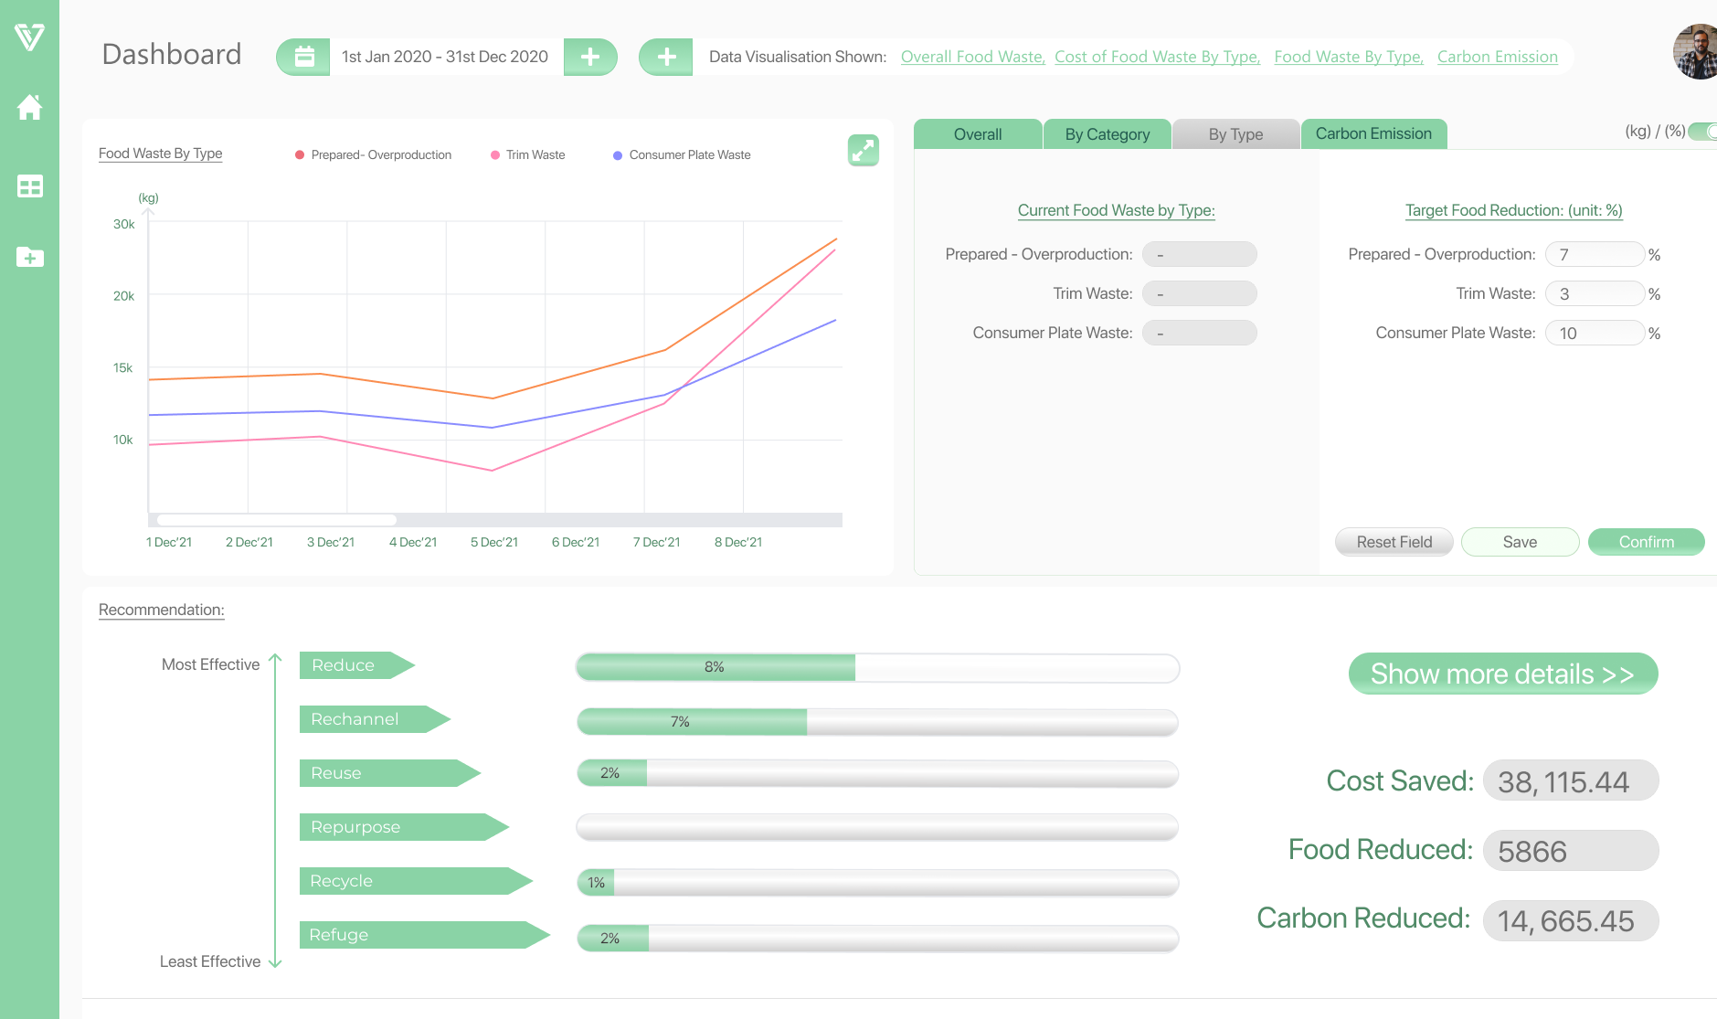
Simulator - ROI
1. You may also choose different categories to simulate
2. You can toggle the unit by KG or %
3. You can also simulate by Type
4. The graph will showcase according to the category you choose

Slide 18
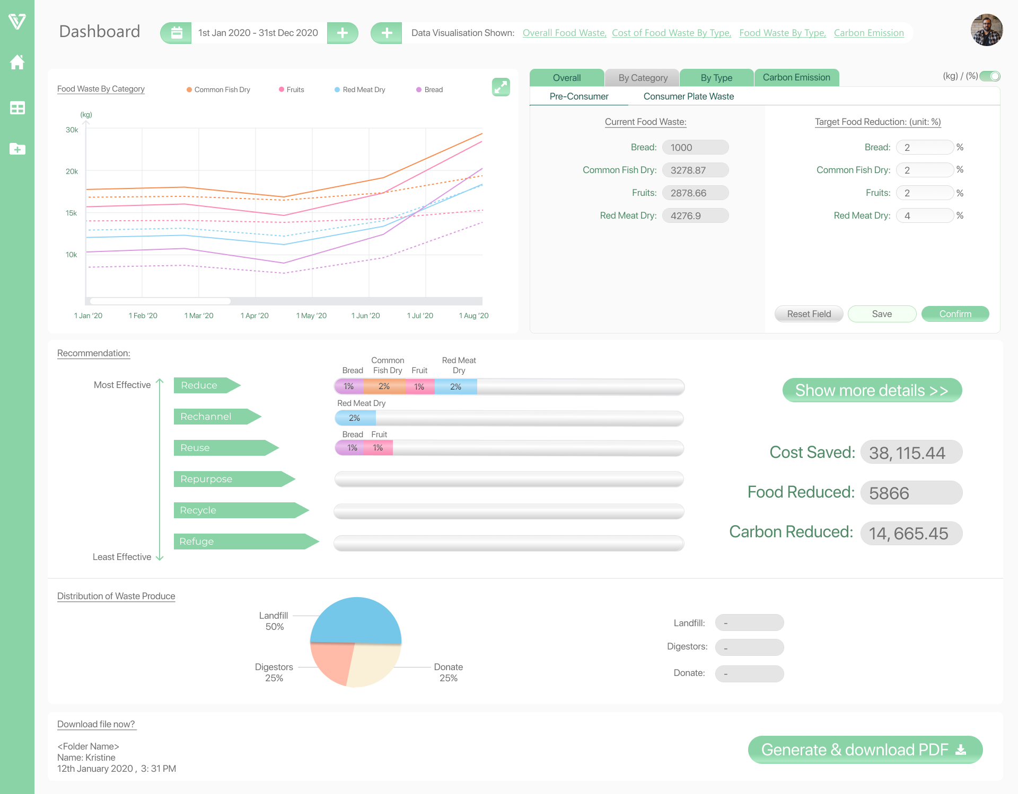
1. By selecting category you will see
Pre-Consumer
Consumer Plate Waste
2. Forecast by items of what and how much to reduce
Simulator – Forecast & Recommendation
4. If you like this forecast, you can choose to “save” and download it later or use it for comparison against your actual data to see how you performed
3. This is recommendation section for your plan of action. The value you key in step 2, the system will recommend possible actions you can take

Slide 19
2. Next you can click on “show more details, to see the information in full detail for (Recommendation section), on the next page
Saving your Forecast
1. Once you click on “save”, this is where you will be able to download the file

Slide 20
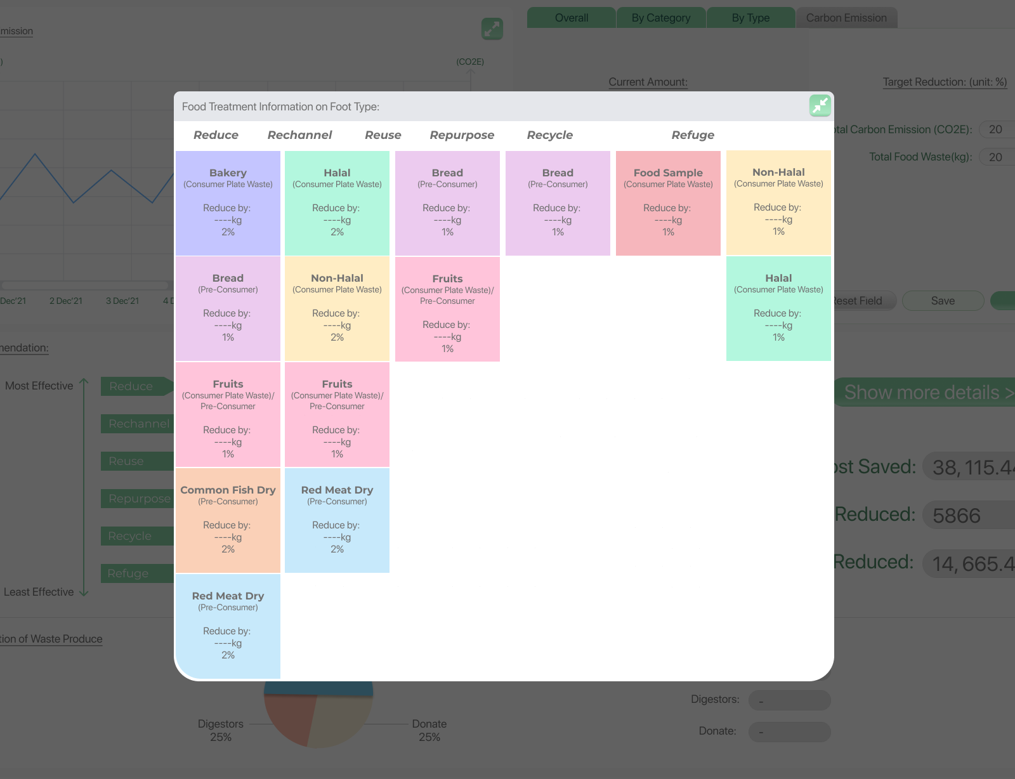
Recommendation for Action
You can view the items that the system has recommended you to do
E.g Fish or Meat that is overprepared at the Kitchen “Overproduction” you will see the recommended amount proposed to reduce, rechannel or reuse
3. Note: How these recommendation work are according to best practices

Slide 21
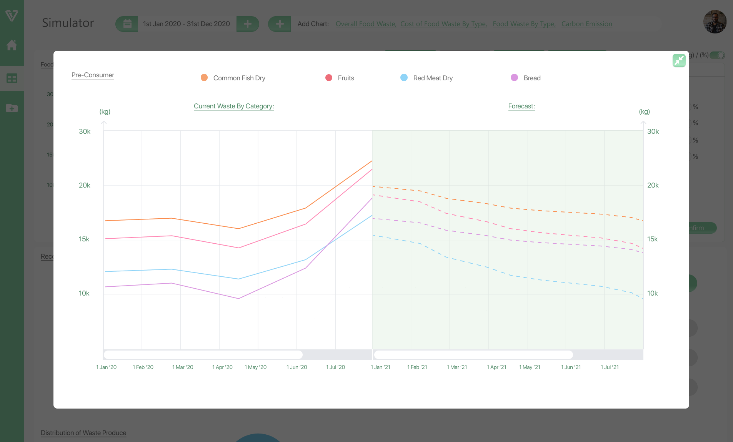
Simulator - Forecast
To view the Forecast, click on it to expand button, it will bring show you the full diagram
E.g. 2021 is the current data you have, you can forecast for 2022
3. Graph for reduction forecast comparison

Slide 22
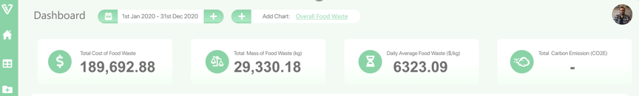
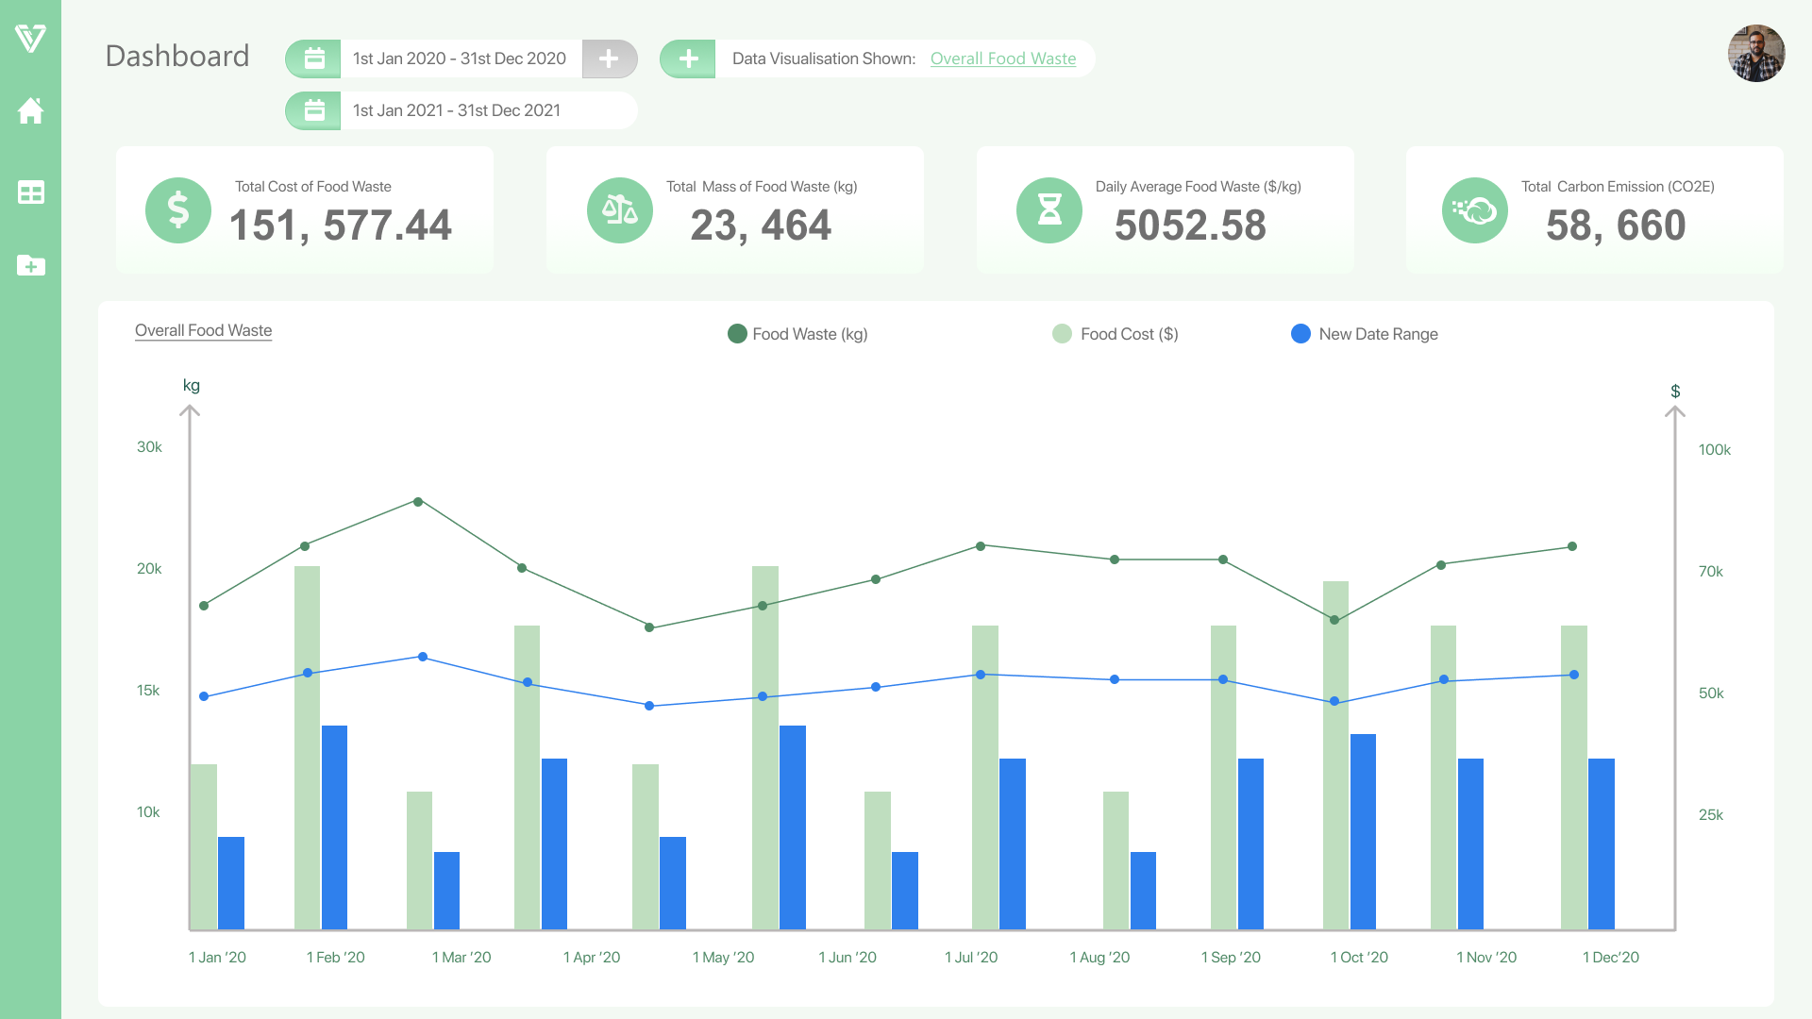
Comparison Chart
20% cost saved!
Bringing you back to the first graph we saw
If connected through API, system will be constantly linked and data will be showcase on a real-time basis.
2. You can upload files to see the comparison:
The actual data for comparison
Or the forecast file saved for comparison

Slide 23
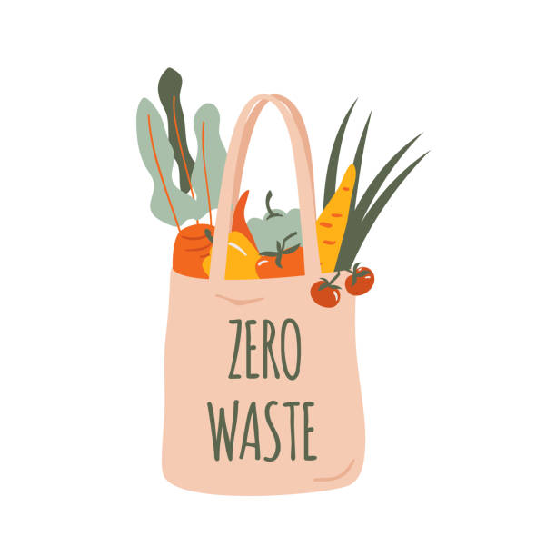

Best Practices for Food Waste
Towards Zero Waste
Circular economy requires data measurement.
It is best to start with prevention, however it is only possible when we have the knowledge on the waste, and followed by the practices:
Reduce
Redistribute / Reuse
Recycle
Recover
Disposal
Prevent & Reduce
Having data and insight allows you to make sound decisions
Redistribute / Reuse
Recycle / Treat
Recover
Energy
Landfill
23

Slide 24

Actionable Steps
Getting Started
Engage our Consultancy services to conduct and assessment with your Stakeholders
We will then make sound recommendations and solutions that fit your business.
Priority
Look at how much we can save for your business as early as now
Options of Green Financing. Look into preparation for performance data, roadmap, value proposition, plans and solutions.
Getting you ready for the future for compliance.
Early Mover Advantage
24

Slide 25

Actionable Steps - Grants
EDG (Enterprise Development Grant)
Funding up to 70%
Qualifying
30% local shareholder, employees < 200
Now
Is the
Right Time
Consultancy
Funding up to 70%
Solution
Funding up to 70%
Approval
8 – 12 weeks
Implementation
Completed within 12 months
25

Slide 26
Actionable Steps – Green Financing
EFS (Enterprise Financial Scheme – Green) | Supportable Areas from Supporting Banks (HSBC, DBS, OCBC, UOB) | Quantum / Max Loan | Repayment period
Working Capital | Expenses related to green initiatives New product development Technology development expenses Consultation & certification fees | S$3 million | Up to 5 years
Solution & Asset | Purchase of equipment and machinery related to green initiatives Construction of factories or purchase of land related to green initiatives | S$30 million | Up to 15 years
M&A | Finance the mergers and acquisition of target enterprises related to green initiatives | S$50 million | Up to 5 years
Opportunities
Available
26

Slide 27




Stay Connected
Call +65 6909 9249
Visit 33 Ubi Ave 3
Vertex #05-01 Singapore 408868
Email hello@visiongroup.co
Web www.visiongroup.co
https://www.linkedin.com/company/visiontoreality/
VisionGroup – VisiontoReality
All rights reserved. © 2022 VisionTech Pte Ltd | Strictly Private and Confidential
27

Slide 28




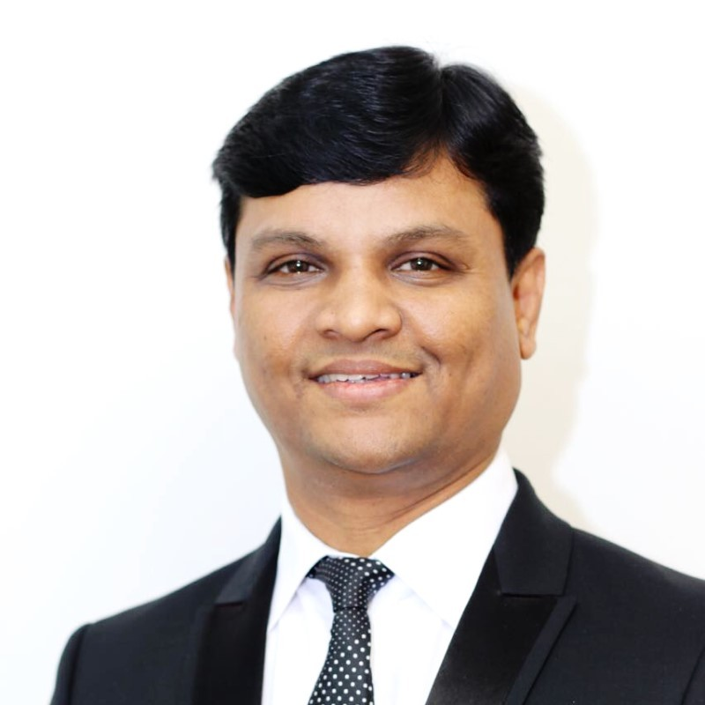
























































































ABOUT US
CORE TECHNOLOGIES
One of the World's Leading Aquaculture Engineering (RAS) company. In the past 4 years, he has been actively involved in assisting governments with their Economic Transformation.
BLOCKCHAIN
TECHNOLOGY
Trust
No
Peace
No
Clarity
Matthew Tan
Co-Chair APEC
Vision is a leading Technology Group providing Innovation-As-A-Service (IAAS) solutions to our clients. We are focused on driving adoption of Artificial Intelligence, Blockchain and Cybersecurity to governments, enterprises and the masses by making it better, faster and easier. Our core sectors of focus are in Commerce, Finance and eGovernment.
Vision
Insights
Future
Proof
Vision
Vanguard
28 years of experience in Sustainability, Engineering, Facilities Management.
Successfully executed food waste management initiatives and embracing of technologies on both food waste reduction and repurposing that resulted in waste reduction.
Vision
Protocol
AI/ML/
ANALYTICS
CYBER SECURITY
Clarity
No
Trust
Peace
of Mind
Syed
Former Head of Sustainability (Macau)
Sands
>42
Industries
>100
Use Cases
>100
References
28
Notes:
https://datatopics.worldbank.org/what-a-waste/trends_in_solid_waste_management.html

Slide 29


Strong Partnerships
You are in safe hands…
What to report?
Benchmark waste production and Co2 Emissions.
Breakdown of waste generated
What are the plans and initiatives
The progress of the waste disposal and recycle activities
Progress and results
Global top 8 Audit firm
Ensure your regulatory & compliance standards.
Specialises in audit and ESG compliance reporting, for Listed Companies & SMEs
Pre-eminent economic forum in the Asia-Pacific region
Support from APEC, Providing support & expertise
Promoting balanced, inclusive, sustainable, innovative and secure growth and by accelerating regional economic integration.
29
Notes:
https://datatopics.worldbank.org/what-a-waste/trends_in_solid_waste_management.html

Slide 30




Pitfalls to Avoid
How to capture?
Measuring right items?
Is this the result you want?
Fresh Food thrown
Wrong method creates a bigger problem for you
0 KG?
Measure & Produce Results
What is the exact solution?
How to measure?
What to measure?
How do you get results?
Reminder that solution takes time for optimised cost.
Is it possible to have the best of all worlds?
30

Slide 31

Why Us?
Regulation & Compliance
Measure the wastes accurately
Generate Graphs and Reports for you
Baker Tilly will audit and create Compliance Reporting
We solve your problems
Lack of Visibility
Give you Data & Analytics
Make recommendations for you to create a plan
Can take Action
Fear of Spending
Get clarity from the solution
Execute plans and save
ROI in > 1 year
31

Slide 32







Actionable Steps
2
Identify key data points captured for analysis
3
Visualisation of data analysis to identify gaps
Yes
Identify Current
Data Points
Data Analytics &
Identify Gaps
4
Visualise end outcomes through actionable KPIs and plans
Existing Green Initiatives
(Food Waste Management)
Simulations &
KPIs Settings
1
Existing system to collect data
Food Waste Management
Platform
No
5
Implementation of solution and analysis results with step 3
Identify Data Collection
Point
Implementation of
Solutions to Achieve KPIs

